Slide 1



Bank Marketing Analysis
View in Power BI
Last data refresh:
27/04/2025 15:30:10 UTC
Downloaded at:
27/04/2025 15:30:51 UTC

Slide 2
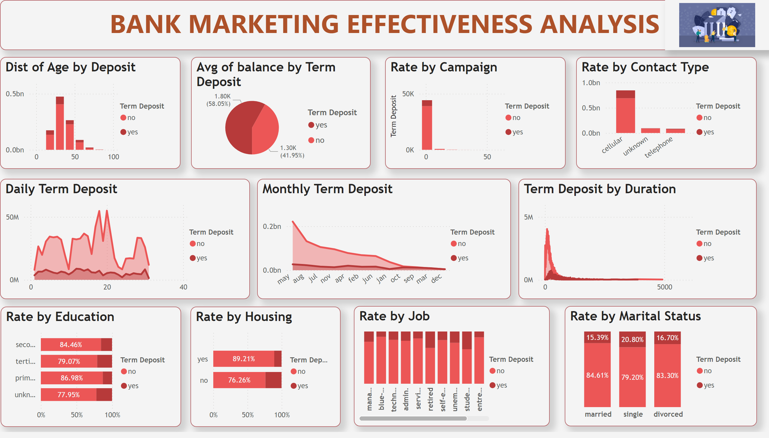
Page 1
Notes:
textbox
No alt text provided
image
No alt text provided
Dist of Age by Deposit
No alt text provided
Avg of balance by Term Deposit
No alt text provided
Rate by Campaign
No alt text provided
Rate by Contact Type
No alt text provided
Daily Term Deposit
No alt text provided
Monthly Term Deposit
No alt text provided
Term Deposit by Duration
No alt text provided
Rate by Education
No alt text provided
Rate by Housing
No alt text provided
Rate by Job
No alt text provided
Rate by Marital Status
No alt text provided

